Slide 1

Windows Forms
Building Smart Client Applications with the .NET Framework
Mark Boulter
Windows Forms Program Manager

Slide 2
Introduction
An overview of Windows Forms
  What is it?
  Why?
  Lots of Demos

Slide 3
Windows Forms
What is it?
  A framework for building Windows applications that takes advantage of all the power of .NET Framework and the Win32® API
  An architecture for controls and containers
  RAD design time experience - Integrated designer support
    .NET Framework built with design-time in mind
    Design-time built using .NET Framework: VS .NET Property Browser, Server Explorer, Windows Forms Designer

Slide 4
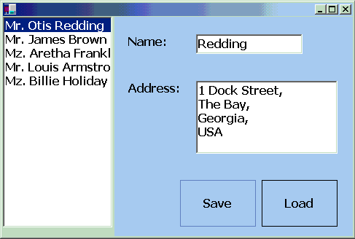
Demo
Building a Windows Forms App
WebService
CustomersList
(Collection)

Slide 5
Windows Forms
Rich set of controls
Advanced graphics support – GDI+
“Money 2000” Flat look
Advanced layout
Visual forms inheritance
Printing support
Accessibility
Extensible:
  Extend and enhance the controls
  and framework
  Easy to add design time behavior
  Drop into direct Win32

Slide 6
Demo
Transparency
Non-rectangular Windows
GDI+

Slide 7
Windows Forms
Can host ActiveX® Controls
International
  Fully Unicode on Windows NT®
  and Windows® 2000
Flexible licensing support

Slide 8
The Smart Client
“No Touch” deployment
  Application isolation is the default
  No registration required
  Versioning – no side affects
  Web based deployment
Secure
  Safe to run downloaded code
Full integration with .NET Framework
  Web Service aware
  Data aware

Slide 9
Security
Code access security makes
Windows Forms controls safe
Execution controlled by:
  Permissions
  Permission Sets
  Code Groups (Zones)
  Code groups have permission sets

Slide 10
Browser Integration
Controls can be hosted Internet Explorer 5x
Low impact
  No installation, registration or GUIDs
Secure
  Code access security prevents harm
  No Internet Explorer security dialogs!
Lightweight
  “Hello World” ~ 3.5K
Easily deployed
  Dependent components are automatically
  downloaded

Slide 11
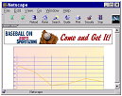

Demo – Controls in the Browser
Client
Web Server
Chart.html
HTTP
Internet Explorer 5x
Web Server
HTTP
Assembly
Cache
Charting.DLL
ChartEngine.DLL
Customizer.DLL

Slide 12
The Smart Client
“Auto” deployment
  No installation
    Use Assembly.LoadFrom
  Stored in the Download cache
    Only downloaded when updated
  Dependent components are automatically downloaded
    Application “trickles” onto the client

Slide 13
Demo – Auto deployment
Smart Client
Web Server
Windows Forms App
Form1
Web Server
HTTP
Assembly
Cache
Form2

Slide 14
Summary
Windows Forms applications are easy to write and easy to deploy
Windows Forms controls are secure, lightweight, and support hosting
on web pages

Slide 15
Resources
Windows Forms Quick Start in the SDK
http://www.gotdotnet.com
MSDN Online
MSDN magazine

Slide 16


